Slide 1
VASIREDDY VENKATADRI INSTITUTE OF TECHNOLOGY
NAMBUR
CONVOLUTION NEURAL NETWORKS
Dr Giri Babu Kande
Professor & Dean (Academics)

Slide 2

automatic tagging algorithms
product recommendations
photo search
home feed personalization

Slide 3

The Problem Space

Slide 4
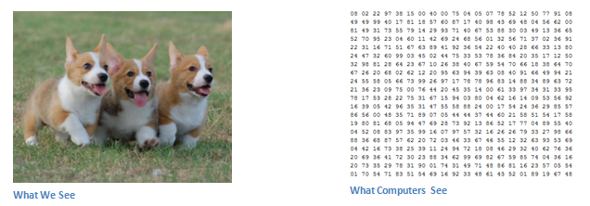
Let’s say we have a color image in JPG form and its size is 480 x 480.
The representative array will be 480 x 480 x 3 (channels = RGB).
Each of these numbers is given a value from 0 to 255 which describes the pixel intensity at that point.
These numbers are the only inputs available to the computer.

Slide 5
Why Convolutional Neural Networks?
Neural Networks are good at Image Recognition.
Now if you consider this image recognition task , this can even be achieved by Neural networks, but the problem is, if the image is of Large pixels then the no. of. parameters for a Neural network increases. This makes Neural networks slow and consumes a lot of computational power.
for Ex: if you process a 64*64*3 size image, then you will get 12288 input parameters. but what if the image is a high resolution with 1000*1000*3, then it has 3million input parameters to process. This takes lot of time and computational power.

Slide 6

Convolutional Neural Networks

Slide 7
Convolutional Neural Networks have 2 main components.
Feature learning: Convolution, ReLU, Pooling layer phases here.
Edges, shades, lines, curves etc are get extracted.
Classification: Fully Connected (FC) layer.
It will assign a probability for the object on the image being what the algorithm predicts it is.

Slide 8
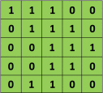
Phase-1: Feature learning
Convolution :
The first layer in a CNN is always a Convolutional Layer.
Input image:
Consider a 5 x 5 image whose pixel values are only 0 and 1 (note that for a grayscale image, pixel values range from 0 to 255, the green matrix below is a special case where pixel values are only 0 and 1):
input image
Filter:
This input image is multiplied by a filter to get the Convolved layer. These filters differ in shapes and in values to get different features like edges, curves, lines. This filter sometimes called as Kernel, Feature detector.

Slide 9
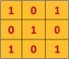

Lets consider 3*3 filter to extract some features from the input image which is in pixel values at input image above.
filter/kernel
Convolved layer:
Each value in each pixel of input image is multiplied with respective value and pixel of filter that gives Convolved layer here. This Conv. layer here sometimes called as Convolutional Feature, Feature map, Filter map here.
(1x1)+(0x1)+(1x1)+(0x0)+(1x1)+(0x1)+
(0x1)+(0x0)+(1x1) = 4
(1x1)+(0x1)+(1x0)+(0x1)+(1x1)+(0x1)+
(0x1)+(0x1)+(1x1) = 3

Slide 10
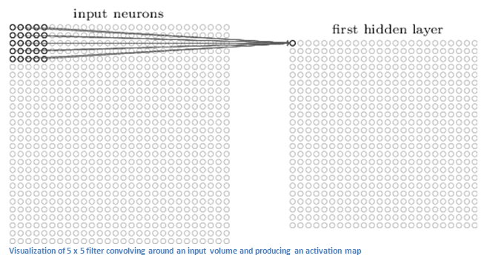
A 32 x 32 input image and a 5 x 5 filter will produce a feature map or activation map of 28 x 28.

Slide 11
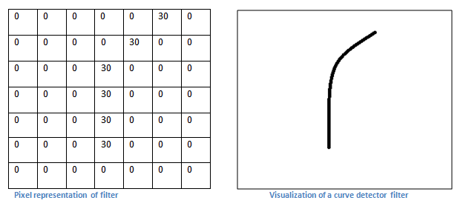
Filters can be thought of as feature identifiers.
Features include straight edges, simple colors, and curves.

Slide 12
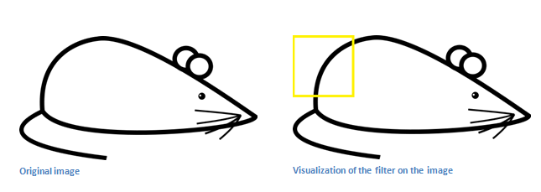
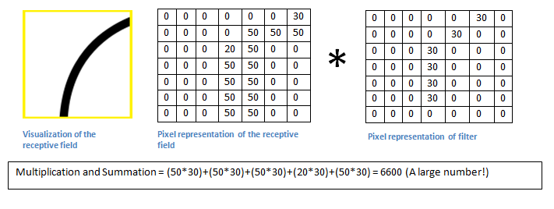
Basically, in the input image, if there is a shape that generally resembles the curve that this filter is representing, then all of the multiplications summed together will result in a large value

Slide 13
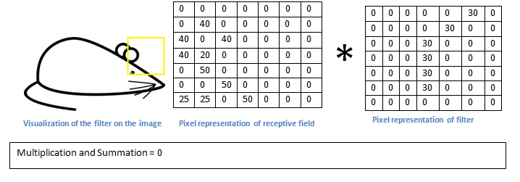
This is just a filter that is going to detect lines that curve outward and to the right.
We can have other filters for lines that curve to the left or for straight edges.
The more filters, the greater the depth of the activation map, and the more information we have about the input volume.

Slide 14
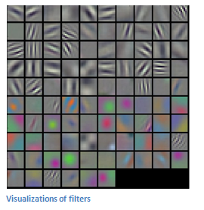

Slide 15
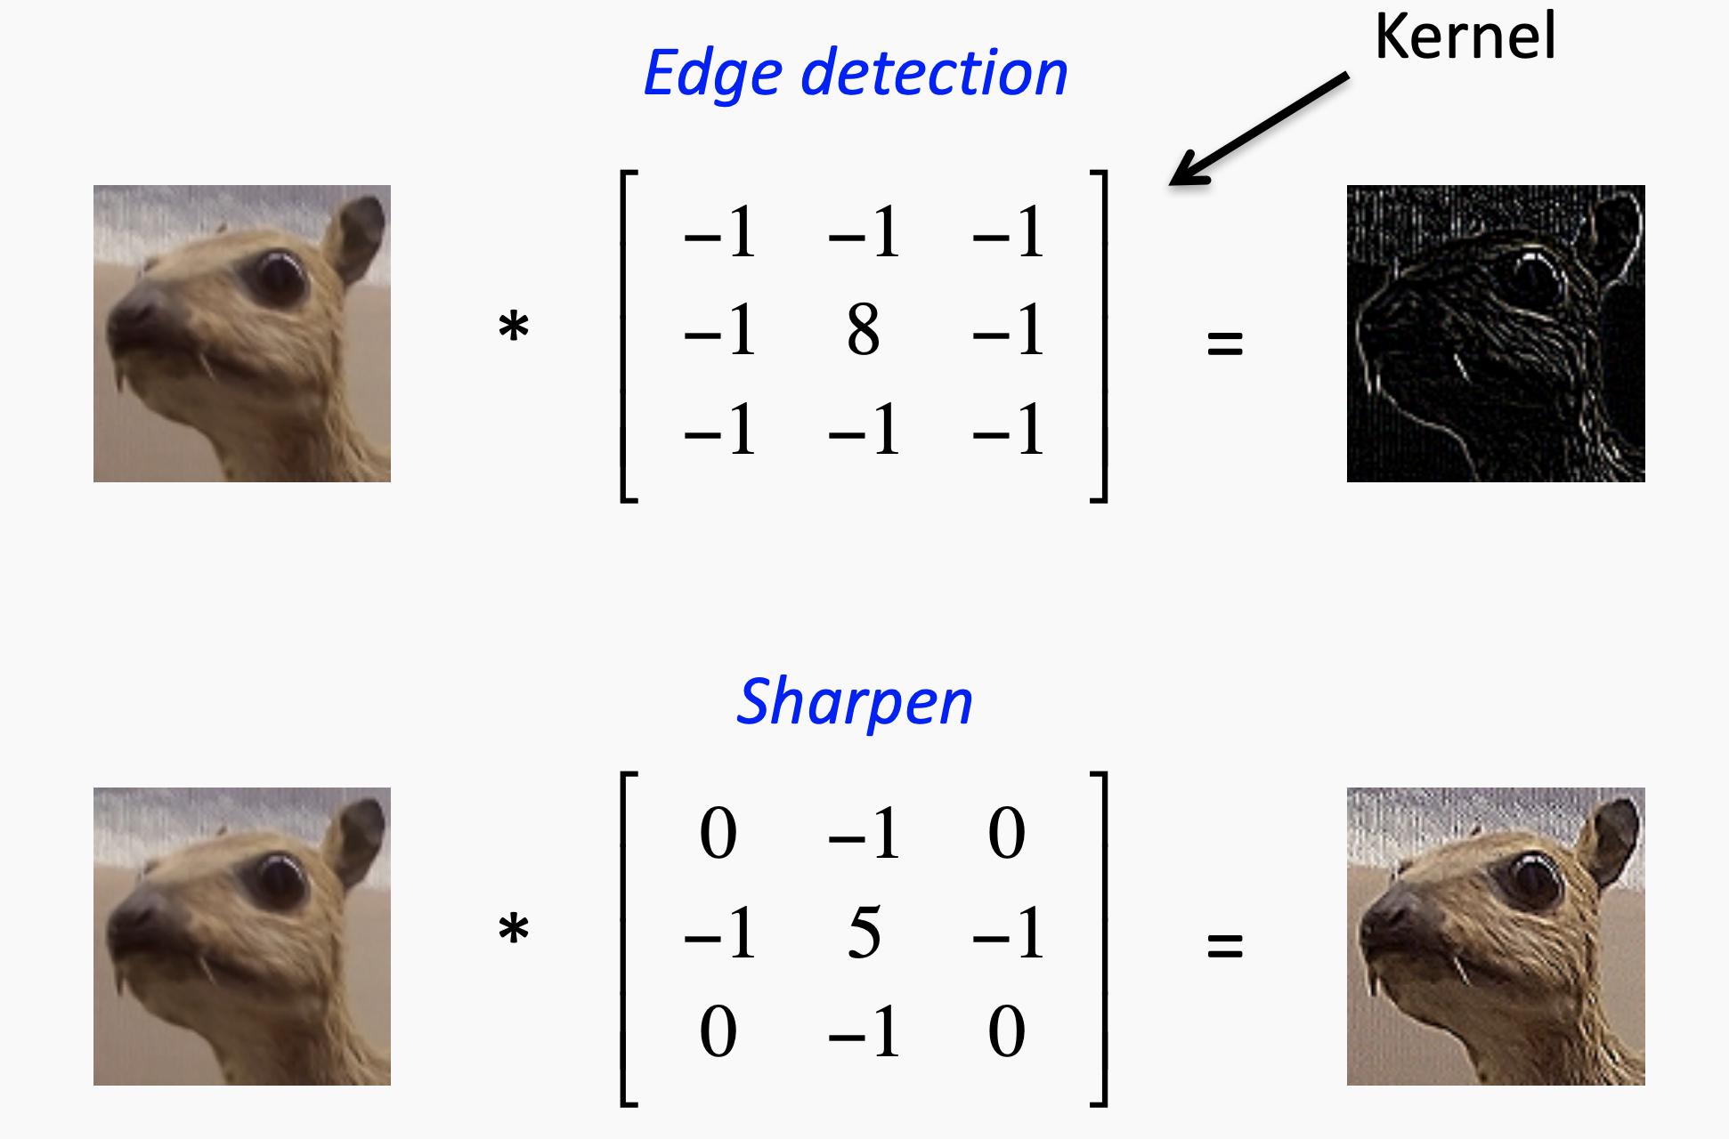

Slide 16


Slide 19
The result of Convolved feature depends on the three parameters, that we need to define before the convolution is performed.
Depth: In the above input image we just considered image with depth =1, but most of the inputs will be of depth =3 which is of 3 channels like Red, Green, Blue.
Stride: Stride is the number of pixels by which we slide our filter matrix over the input matrix. When the stride is 1 then we move the filters one pixel at a time. When the stride is 2, then the filters jump 2 pixels at a time as we slide them around. Having a larger stride will produce smaller feature maps.

Slide 20
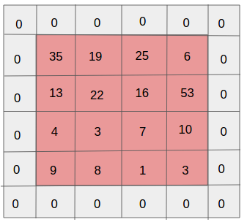
Padding: is like how many pixel you add extra to image. Mostly padding would be 1.

Slide 21
Convolution Example
Input volume: 3 x 32 x 32
10 5x5 filters with stride 1, pad 2
Output volume size: ?

Slide 22
Convolution Example
Input volume: 3 x 32 x 32
10 5x5 filters with stride 1, pad 2
Output volume size:
(32+(2*2)-5)/1+1 = 32 spatially, so 10 x 32 x 32

Slide 23
Convolution Example
Input volume: 3 x 32 x 32
10 5x5 filters with stride 1, pad 2
Output volume size: 10 x 32 x 32
Number of learnable parameters: ?

Slide 24
Convolution Example
Input volume: 3 x 32 x 32
10 5x5 filters with stride 1, pad 2
Output volume size: 10 x 32 x 32
Number of learnable parameters: 760
Parameters per filter: 3*5*5 + 1 (for bias) = 76 10 filters, so total is 10 * 76 = 760

Slide 25
Convolution Example
Input volume: 3 x 32 x 32
10 5x5 filters with stride 1, pad 2
Output volume size: 10 x 32 x 32
Number of learnable parameters: 760
Number of multiply-add operations: ?

Slide 26
Convolution Example
Input volume: 3 x 32 x 32
10 5x5 filters with stride 1, pad 2
Output volume size: 10 x 32 x 32
Number of learnable parameters: 760
Number of multiply-add operations: 768,000
10*32*32 = 10,240 outputs; each output is the inner product of two 3x5x5 tensors (75 elements); total = 75*10240 = 768K

Slide 27
Summary:
To summarize, the Conv Layer:
Accepts a volume of size W1×H1×D1
Requires four hyper parameters: Number of filters K, their filter size F, the stride S, the amount of zero padding P.
Produces a volume of size W2×H2×D2 where:
— W2=(W1−F+2P)/S+1
— H2=(H1−F+2P)/S+1 (i.e. width and height are computed equally by symmetry)
— D2=K

Slide 28
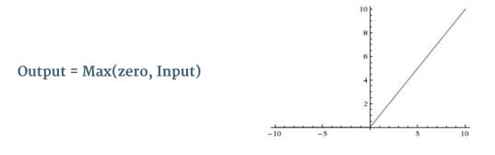
ReLU(Rectified Linear Unit):
An additional operation called ReLU has been used after every Convolution operation. ReLU is a non- linear operation
Rectified Linear Unit function
ReLU is an element wise operation (applied per pixel) and replaces all negative pixel values in the feature map by zero. The purpose of ReLU is to introduce non-linearity in our ConvNet, since most of the real-world data we would want our ConvNet to learn would be non-linear (Convolution is a linear operation — element wise matrix multiplication and addition, so we account for non-linearity by introducing a non-linear function like ReLU).

Slide 29

Left:before ReLU applied.,Right:after ReLU applied

Slide 30
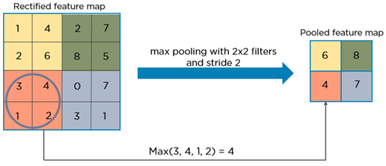
Pooling layer
In this phase the dimensionality of conv.layer or feature map gets reduced keeping the important information. sometimes this spatial pooling is also called Downsampling or subsampling. This pooling layers may be Max pooling, Avg pooling, sum pooling. Mostly Max pooling is used.
Max pooling on ReLU feature map

Slide 31
Why pooling?
Invariance:
Pooling helps to make the representation become approximately invariant to small translations of the input.
Invariance to translation means that if we translate the input by a small amount, the values of most of the pooled outputs do not change.
Invariance to local translation can be a very useful property if we care more about whether some feature is present than exactly where it is.
The use of pooling can be viewed as adding an infinitely strong prior that the function the layer learns must be invariant to small translations.
Efficiency:
Pooling units summarize detector units by reporting summary statistics for pooling regions spaced k pixels apart rather than 1 pixel apart.
This improves the computational efficiency of the network
improved statistical efficiency and reduced memory requirements for storing the parameters.

Slide 32
Accepts a volume of size W1×H1×D1
Requires two hyperparameters:
— their spatial extent F,
— the stride S,
Produces a volume of size W2×H2×D2
where:
— W2=(W1−F)/S+1
— H2=(H1−F)/S+1
— D2=D1

Slide 33
Classic CNN architecture

Slide 34
Phase-2:Classification
Fully connected layer
The Fully Connected layer is a traditional Multi Layer Perceptron that uses a softmax activation function in the output layer .
The term “Fully Connected” implies that every neuron in the previous layer is connected to every neuron on the next layer.

Slide 35
The output from the convolutional and pooling layers represent high-level features of the input image. The purpose of the Fully Connected layer is to use these features for classifying the input image into various classes based on the training dataset.
The sum of output probabilities from the Fully Connected Layer is 1. This is ensured by using the Softmax as the activation function in the output layer of the Fully Connected Layer.
The Softmax function takes a vector of arbitrary real-valued scores and squashes it to a vector of values between zero and one that sum to one.

Slide 36
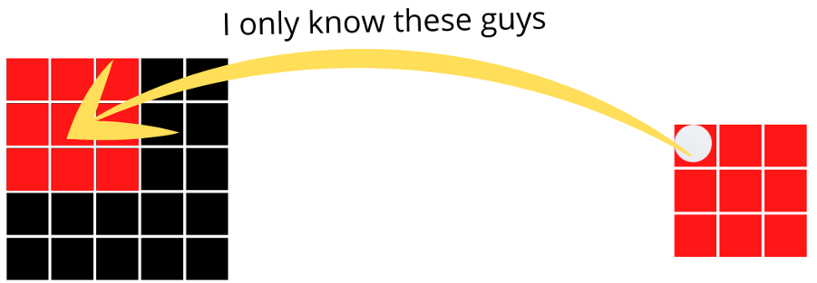
Receptive field for CNN
In the perspective of a human being, the receptive field indicates how wide you can see

Slide 37
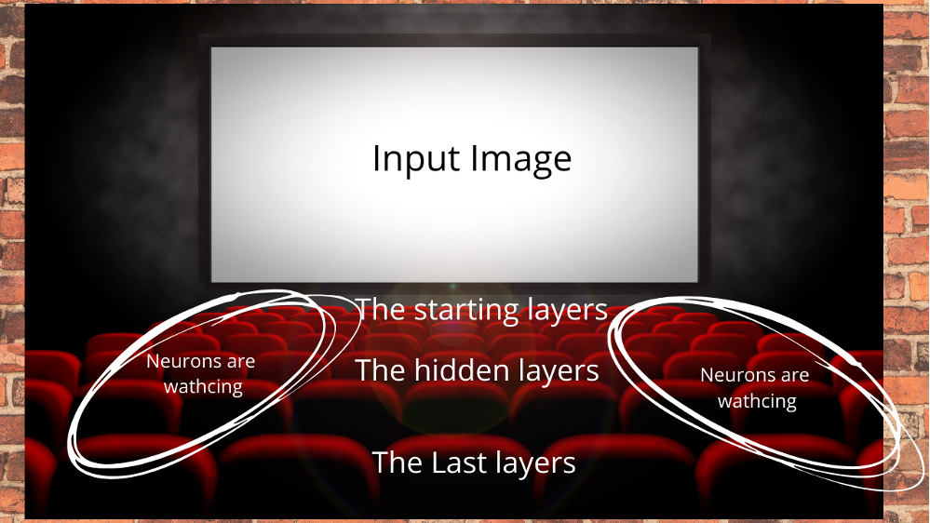
We can assume these rows as the layers of the neural network. The first row means the first layer, which does not have the whole idea of the screen or in the case of a neural network, the input image. On the other hand, the last row means the last layer, which has the whole idea of the image without any problem.

Slide 38
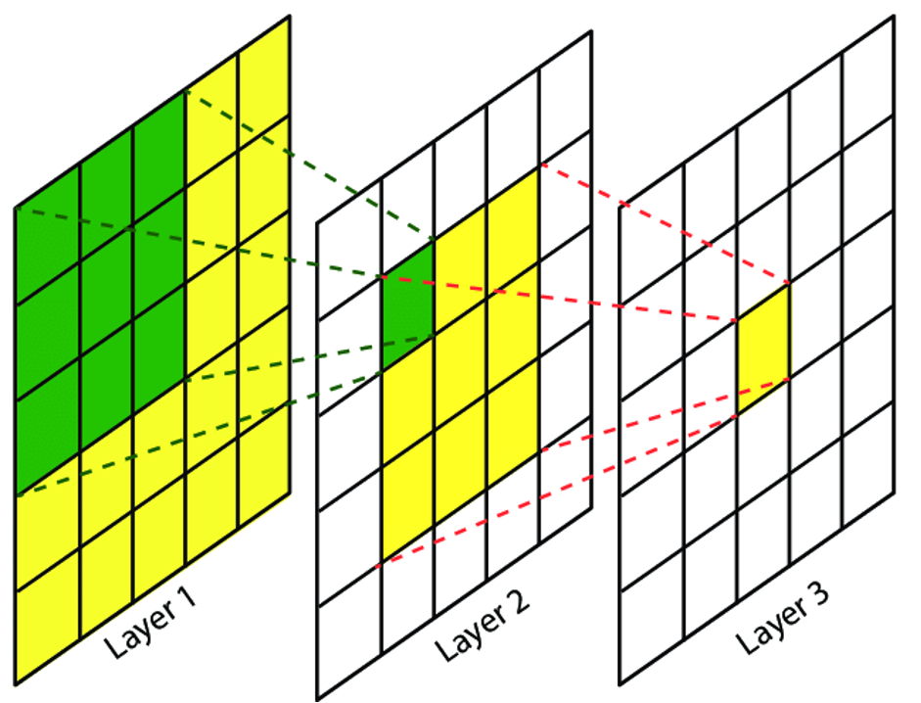
As soon as we move to the next layer, we can see the output feature map has the idea of every 3x3 pixel of the image. Furthermore, another kernel of 3x3 is moving through this feature map, and has the idea of all these pixels.
The first layer has a kernel of 3x3 moving from the input image. In this case, we talk about just one layer, which is the local receptive field. Since at a time, our kernel can just see the pixels of 3x3, our local receptive field, becomes 3x3.
The local receptive field of both the layers are 3 since the kernel can only see 3x3 pixels at a time. So, we can come to the conclusion that the receptive field directly depends on the kernel size.

Slide 39
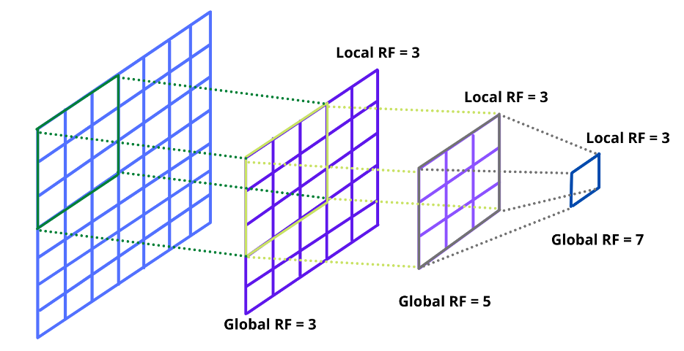

Slide 40
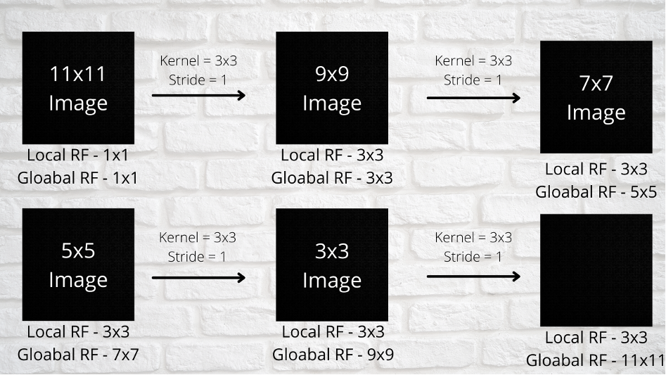
Each time the local receptive field is not changing since we can use the same kernel and the global receptive field is increasing

Slide 41
At the beginning, the kernel tries to extract the small features, like edges and gradients and only has an idea about those. However, as soon as it moves to the next layer, it starts getting a larger perspective of the image and notices the pattern and textures. Furthermore, in the final layer, our network is able to build the complete object.

Slide 42
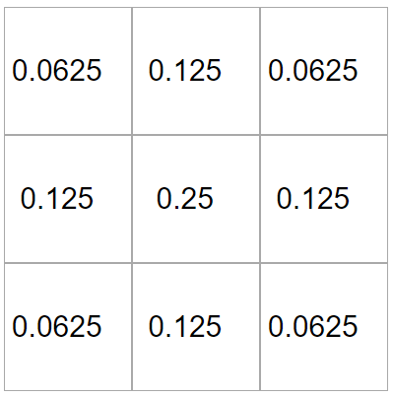
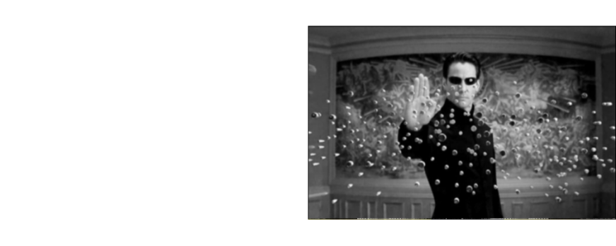
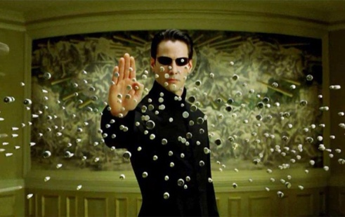
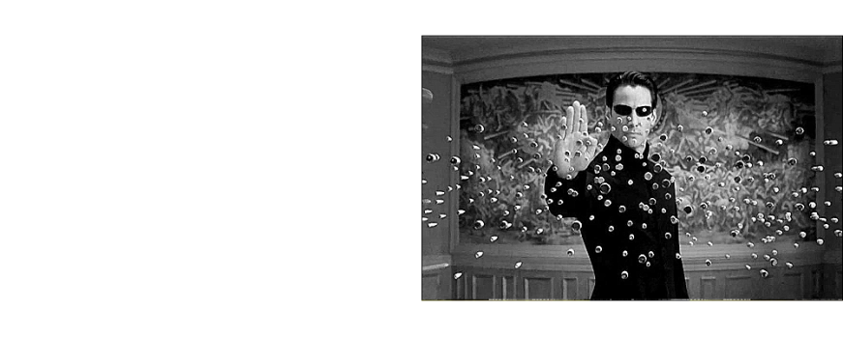
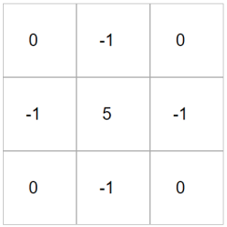
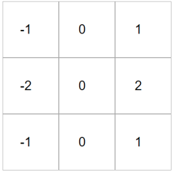
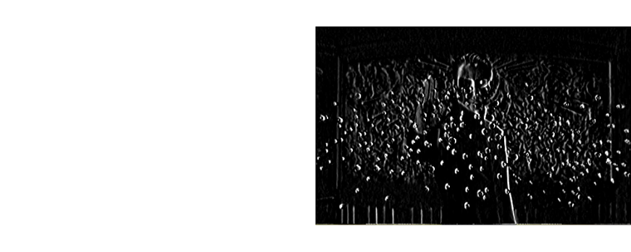
Convolutions are filtering operations
Different filter (kernel) sizes unveil different image feature information
Commonly in two steps:
Slide the same fixed kernel across the image
Calculate the dot product between kernel and image
Blurring
*
Sharpening
*
Let’s try together
*
Edge

Slide 43

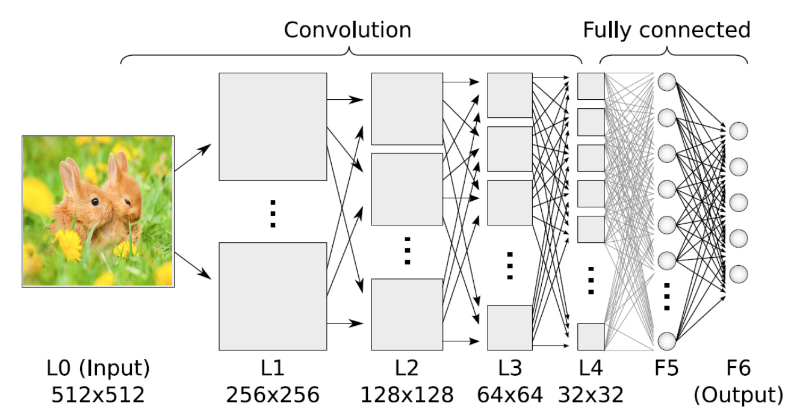

Extracting Image Features via ConvOps
Extracting useful information from image
Sliding windows (kernels or filters) are used to convolve an input image
panda

Slide 44
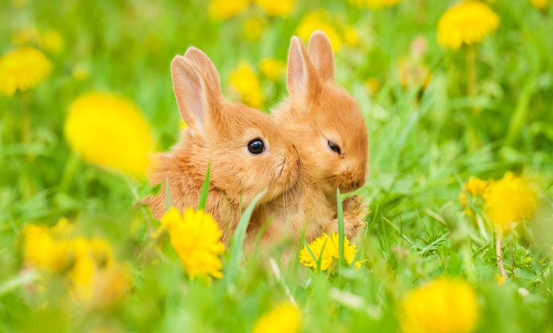
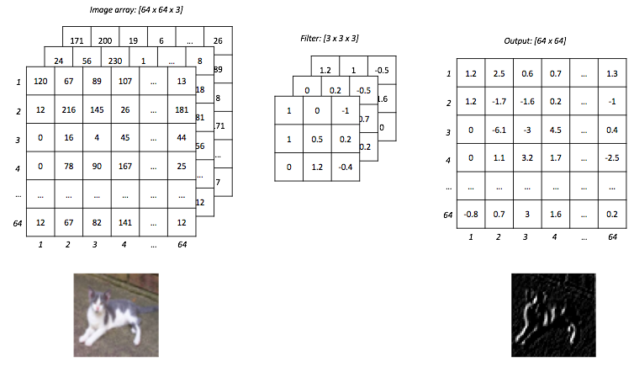
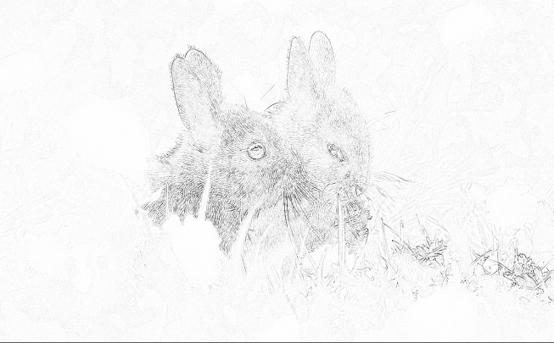
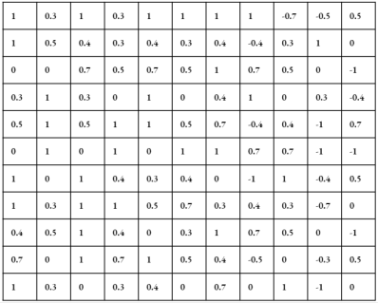
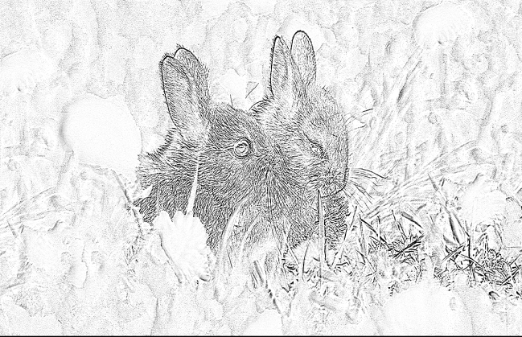
3x3 vs 11x11
Filter size: 11x11
Bigger filter size, more
global information captured
B
G
R
Filter size: 3x3
Smaller filter size more local information captured

Slide 45

LeNet5 by Lecun et al 1998
Layer 1
Layer 3
Layer5
Input image

Slide 46
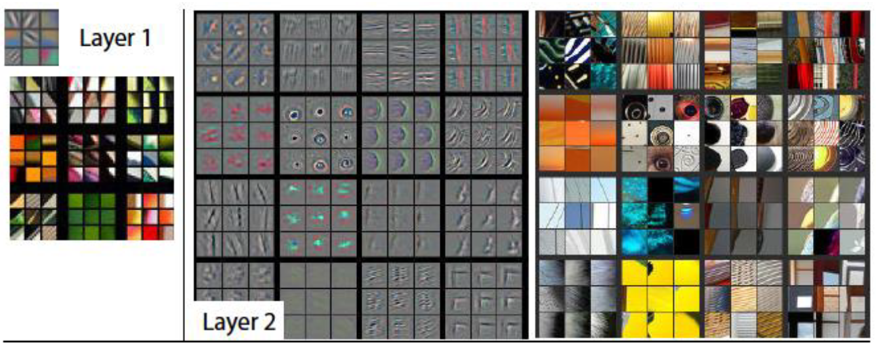
Layer depth
First layers detect simple patterns (colors, edges, etc.)
Deeper layers detects more complex patterns which is built upon the output of the first layers.

Slide 47
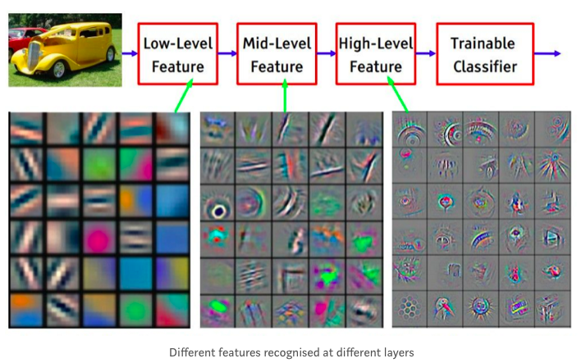
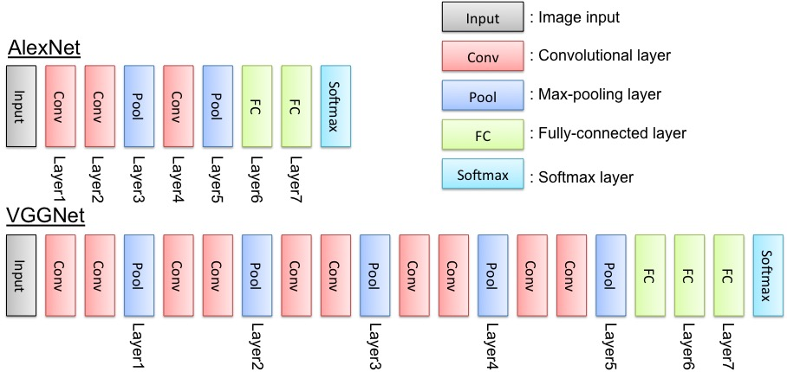
Convolutions in CNN Architectures
Building blocks of common CNN architectures:
Feature Extraction:
Convolution operation
Activation function
Max (mean, global, etc) pooling
Classification/Regression:
features
kernel size: spatial dimensions of filter, usually odd numbers
simple
complex
stride: controls how the filter convolves around input tensor
Padding: controls the spatial dimensions of output tensor

Slide 48
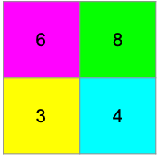

Convolution Layer Hyperparameters
kernel size
3x3
1 | 1 | 2 | 4
5 | 6 | 7 | 8
3 | 2 | 1 | 0
1 | 2 | 3 | 4
stride
1
padding
same
Max
2x2, 2
1 | 1 | 2 | 4
5 | 6 | 7 | 8
3 | 2 | 1 | 0
1 | 2 | 3 | 4
Global
avg
3.1
Convolution Visualizer

Slide 49
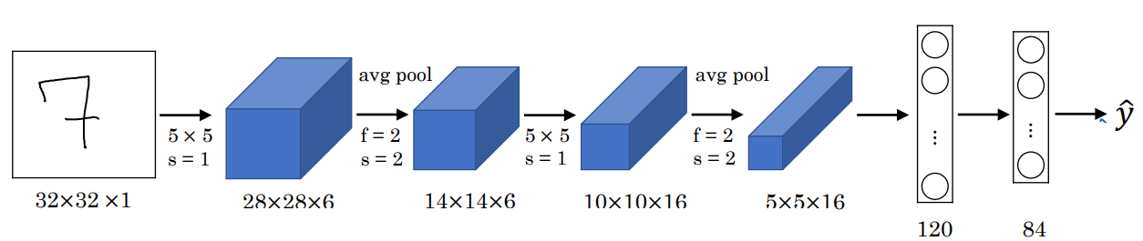

Slide 50
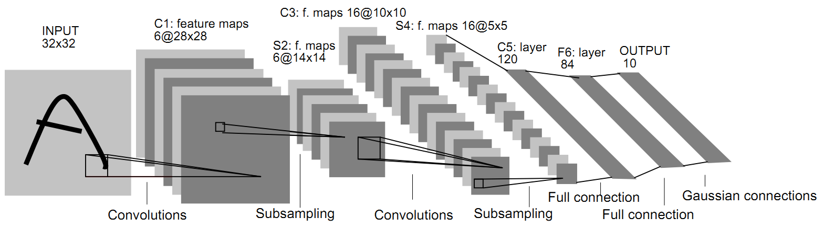
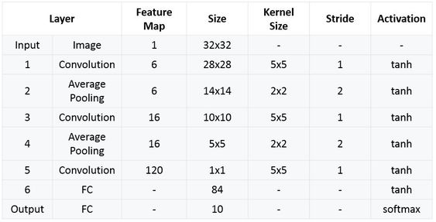
LeNet Architecture

Slide 51
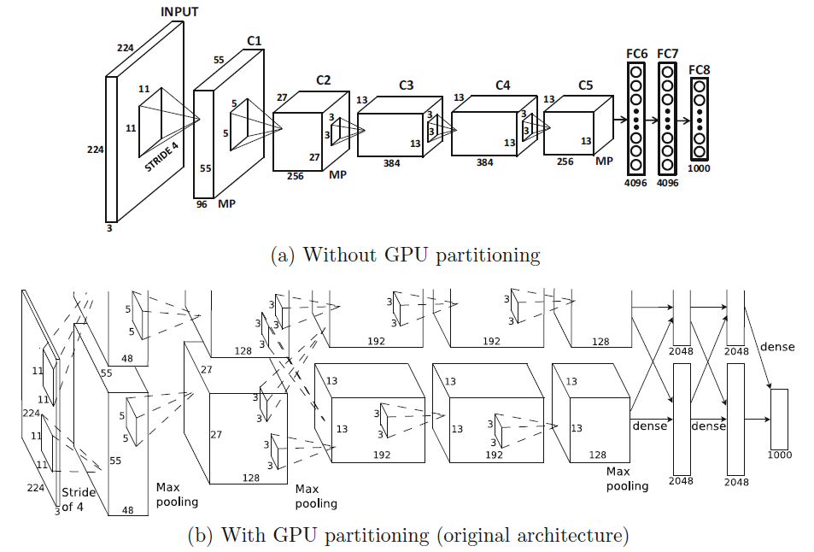
AlexNet
AlexNet was the winner of the 2012 ILSVRC competition.

Slide 52
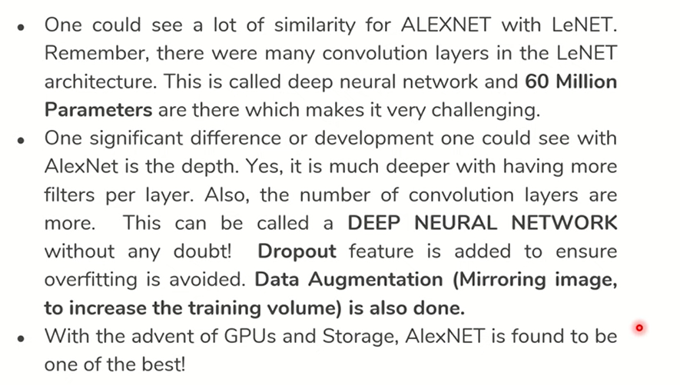
AlexNet

Slide 53
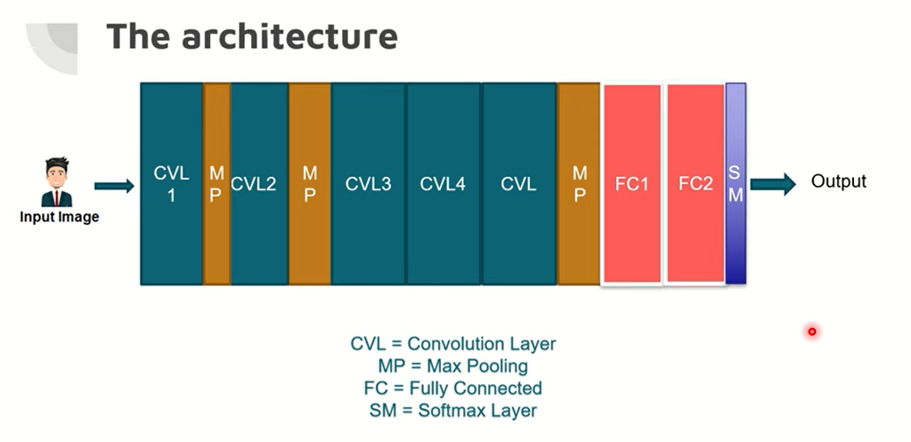

Slide 54
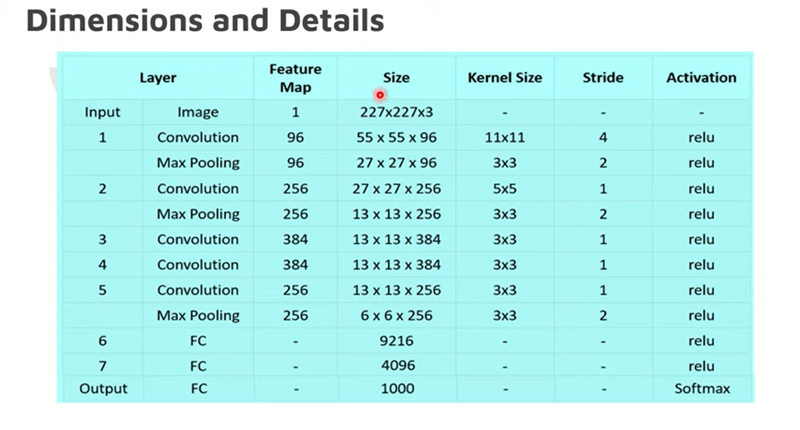

Slide 55
Output image size=(n-f+2p)/s+1

Slide 56
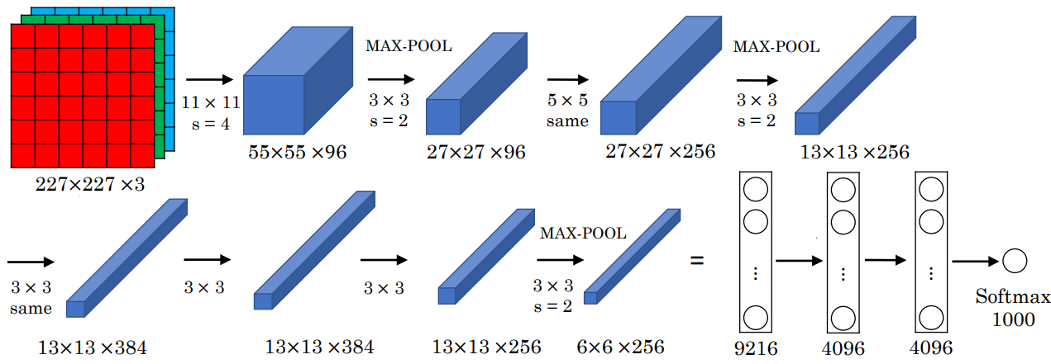

Slide 57
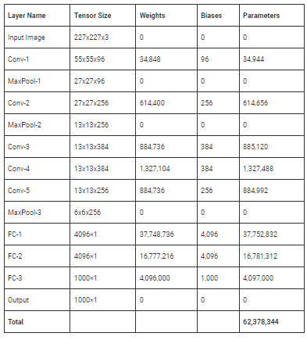

Slide 58
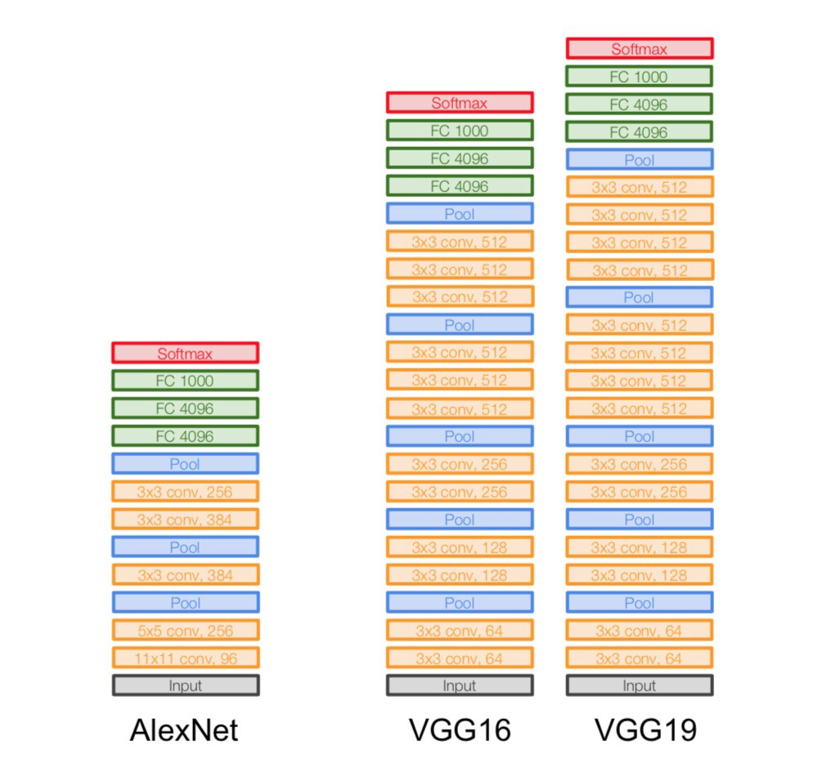
AlexNet
Convolution filter sizes:
Alexnet : 11x11 , 3x3 , 5x5
How deep networks:
AlexNet : 7 Layer
It is worth mentioning that there were two parallel pipelines of processing in the original architecture
These two pipelines are caused by two GPUs working together to build the training model with a faster speed and memory sharing.
The network was originally trained on a GTX 580 GPU with 3 GB of memory, and it was impossible to fit the intermediate computations in this amount of space. Therefore, the network was partitioned across two GPUs.

Slide 59
AlexNet
Convolution filter sizes:
Alexnet : 11x11 , 3x3 , 5x5
How deep networks:
AlexNet : 7 Layer
First Conv Layer
AlexNet starts with 224 × 224 × 3 images and uses 96 filters of size 11 × 11 × 3 in the first layer.
A stride of 4 is used.
This results in a first layer of size 55 × 55 × 96. After
the first layer has been computed, a max-pooling layer is used.
The ReLU activation function was applied after each convolutional layer, which was followed by response normalization and max-pooling. Although max-pooling has been annotated in the figure, it has not been assigned a block in the architecture.

Slide 60
AlexNet
Convolution filter sizes:
Alexnet : 11x11 , 3x3 , 5x5
How deep networks:
AlexNet : 7 Layer
Second Conv Layer
The second convolutional layer uses the response-normalized and pooled output of the first convolutional layer and filters it with 256 filters of size 5 × 5 × 96.
Third, Fourth, and Fifth Conv Layers
The sizes of the filters of the third, fourth, and fifth convolutional layers are 3 × 3 × 256 (with 384 filters), 3 × 3 × 384 (with 384 filters), and 3 × 3 × 384 (with 256 filters).
No intervening pooling or normalization layers are present in the third, fourth, or fifth convolutional layers.

Slide 61
AlexNet
Convolution filter sizes:
Alexnet : 11x11 , 3x3 , 5x5
How deep networks:
AlexNet : 7 Layer
Pooling
All max-pooling layers used 3 × 3 filters at stride 2. Therefore, there was some overlap among the pools.

Slide 62
Efficiency & Computation
 | AlexNet | VGG-16
# of Convolution Layers | 5 | 13
Convolution Parameters | 3.8M | 15M
# of FC Layers | 3 | 3
FC Layer Parameters | 59M | 59M
Total Params | 62M | 138M
ImageNet Error | 17% | 7.3%

Slide 63
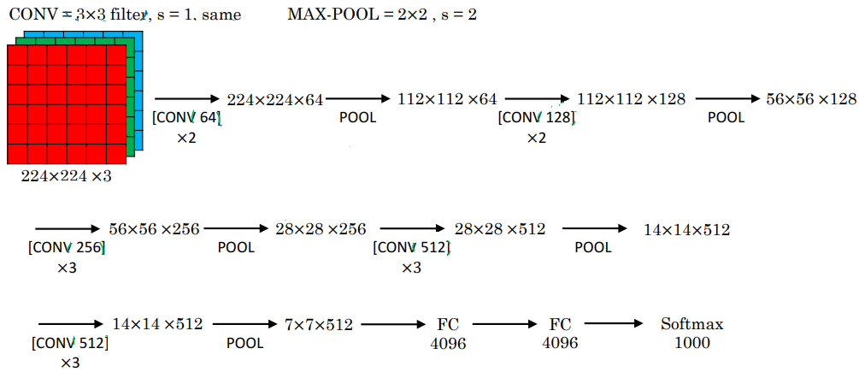
VGG-16

Slide 64
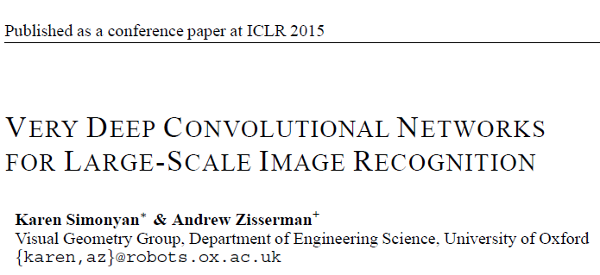
VGG-16
ISLVRC 2014
Second in classification
First in localization
VGG was important because it illustrated several important design principles that eventually became standard in future architectures.
PROBLEMS THE PAPER ADDRESSED
To show that
making a network deeper improves its accuracy, and also
multiple small filters are better than a single large filter when both have same receptive field areas on the input image.
DESIGN PRINCIPLES ILLUSTRATED
Reduced filter size necessitates increased depth
This is because a small filter can capture only a small region of the image unless the network is deep.
https://arxiv.org/pdf/1409.1556.pdf
Small Filters vs Large Filters
Shallow Network vs Deeper Network

Slide 65
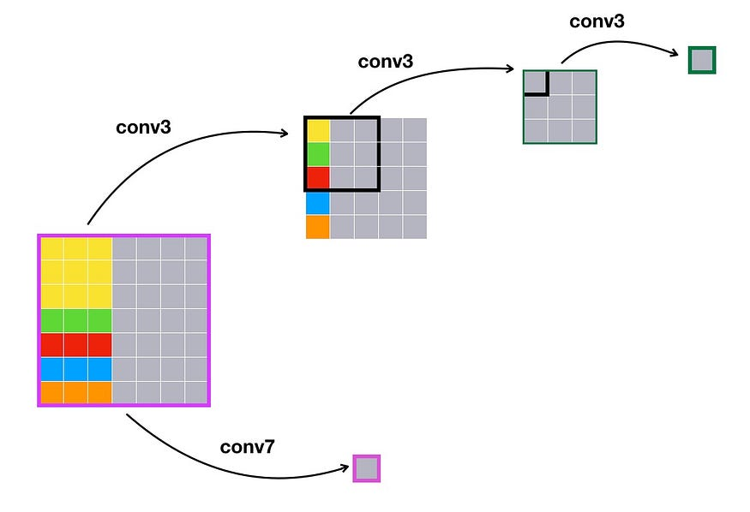
VGG-16
Small Filters vs Large Filters
3x3
7x7
Single feature computed on the input of size 7x7
Need 3 sequential convolutions
Single convolution is sufficient
Number of parameters required
Type of features captured

Slide 66
VGG-16
Small Filters vs Large Filters
3x3
7x7
Single feature computed on the input of size 7x7
Need 3 sequential convolutions
Single convolution is sufficient
Number of parameters required
3x3x3=27
7x7x1=49
Type of features captured

Slide 67
VGG-16
Small Filters vs Large Filters
3x3
7x7
Single feature computed on the input of size 7x7
Need 3 sequential convolutions
Single convolution is sufficient
Number of parameters required
3x3x3=27
7x7x1=49
Type of features captured
can often capture more interesting and complex features
Features captured look like primitive edge features
Unable to capture sophisticated shapes in smaller regions

Slide 68
VGG-16
Shallow Network vs Deeper Network
Greater depth forces
MORE NONLINEARITY
because of the presence of more ReLU layers
GREATER REGULARIZATION
because the increased depth forces a structure on the layers through the use of repeated composition of convolutions
Summary of using
Architectures with greater depth and reduced filter size
Require fewer parameters, because the number of parameters in each layer is given by
the square of the filter size, whereas
depend linearly on the depth.
Therefore, one can drastically reduce the number of parameters by using smaller filter sizes, and instead “spend” these parameters by using increased depth.
Increased depth also allows the use of a greater number of nonlinear activations, which increases the discriminative power of the model.

Slide 69
VGG-16
DESIGN CHOICES
Key idea
The idea was to always increase the depth by a factor of 2 whenever the spatial footprint reduced by a factor of 2.
This design choice results in some level of balance in the computational effort across layers, and was inherited by some of the later architectures like ResNet.
No. of Layers
The tested networks were designed with various configurations with sizes between 11 and 19 layers
The best-performing versions had 16 or more layers.

Slide 70
VGG-16
DESIGN CHOICES
Filter sizes, padding, and stride
VGG always uses filters with spatial footprint 3×3 and pooling of size 2×2.
The convolution was done with stride 1, and a padding of 1 was used.
The pooling was done at stride 2.
Using a 3 × 3 filter with a padding of 1 maintains the spatial footprint of the output volume, although pooling always compresses the spatial footprint.
Therefore, the pooling was done on non-overlapping spatial regions (unlike the previous two architectures), and always reduced the spatial footprint (i.e., both height and width) by a factor of 2.
Another interesting design choice of VGG was that the number of filters was often increased by a factor of 2 after each max-pooling.

Slide 71
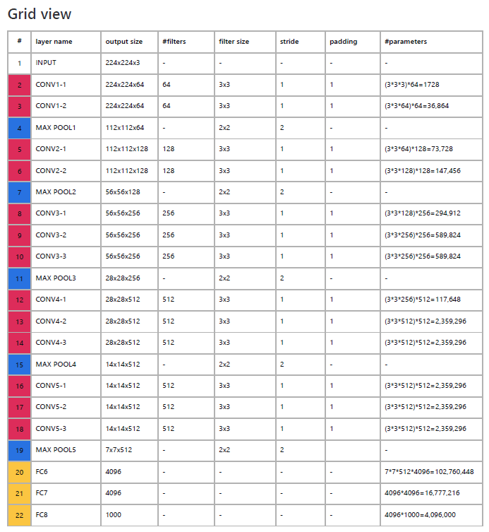
Nearly 75% of the parameters are in a single layer of connections.
7x7x512x4096=102,760,448

Slide 72
VGG-16
TRAINING
Batch size 256
SGD Momentum 0.9
Dropout 0.5
Learning rate 0.01, reduced by 10 manually when val accuracy plateaus (the learning rate was decreased 3 times, and the learning was stopped after 370K iterations (74 epochs))
L2 weight decay 5e-4
Data augmentation is similar to Krizhevsky 2012(AlexNet)
PERFORMANCE
The top-5 error rate is 7.3%

Slide 73
VGG-16
OTHER ISSUES
Stability
The increased depth led to greater sensitivity with initialization, which is known to cause instability.
This problem was solved by using pretraining, in which a shallower architecture was first trained, and then further layers were added.
However, the pretraining was not done on a layer-by-layer basis.
Rather, an 11-layer subset of the architecture was first trained.
These trained layers were used to initialize a subset of the layers in the deeper architecture.

Slide 74
Thank You

